Slide 1
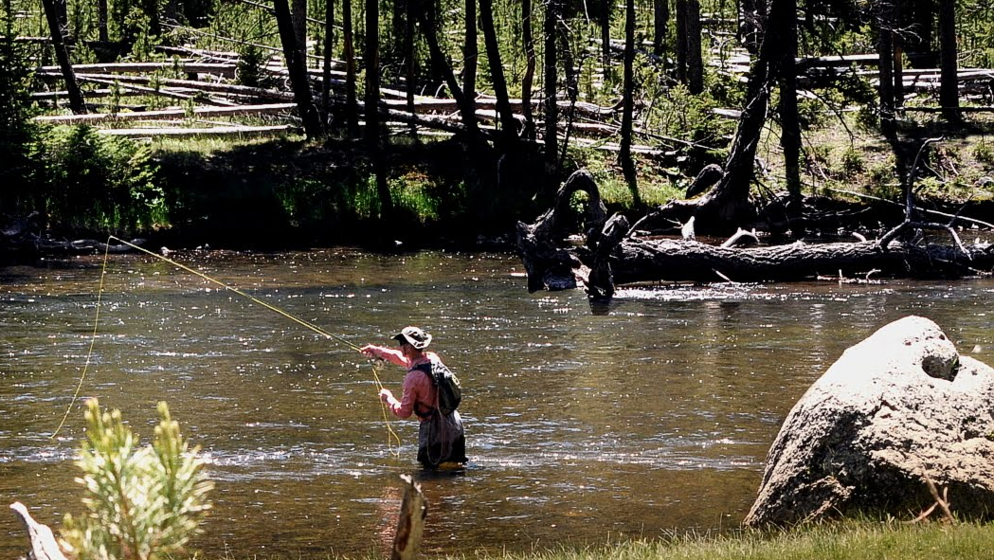
Fishing Data Consulting
STAT 649
Minjee Kim

Slide 2
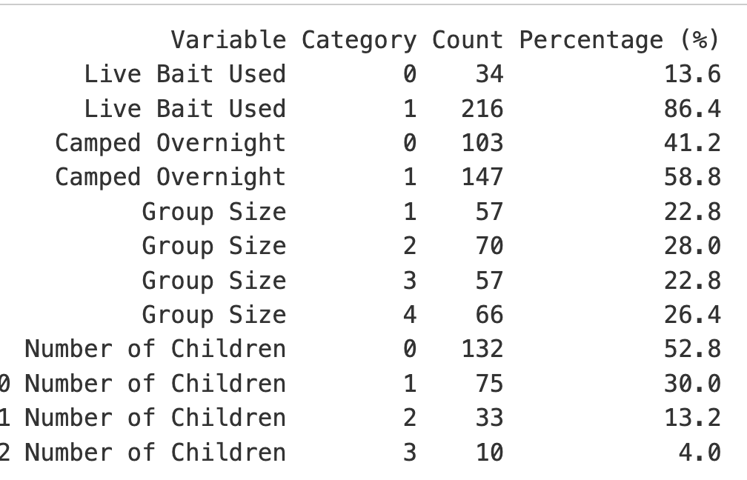
Introduction
The dataset consists of records at a state park, where visitors reported the number of fish they caught.
Objective: To predict the number of fish caught by (each group) of fishermen.
Predictors:
Livebait: whether livebait was used
Camper: whether they camped
Persons: number of people in group
Child: number of children in group
Response:
Count: number of fish caught

Slide 3
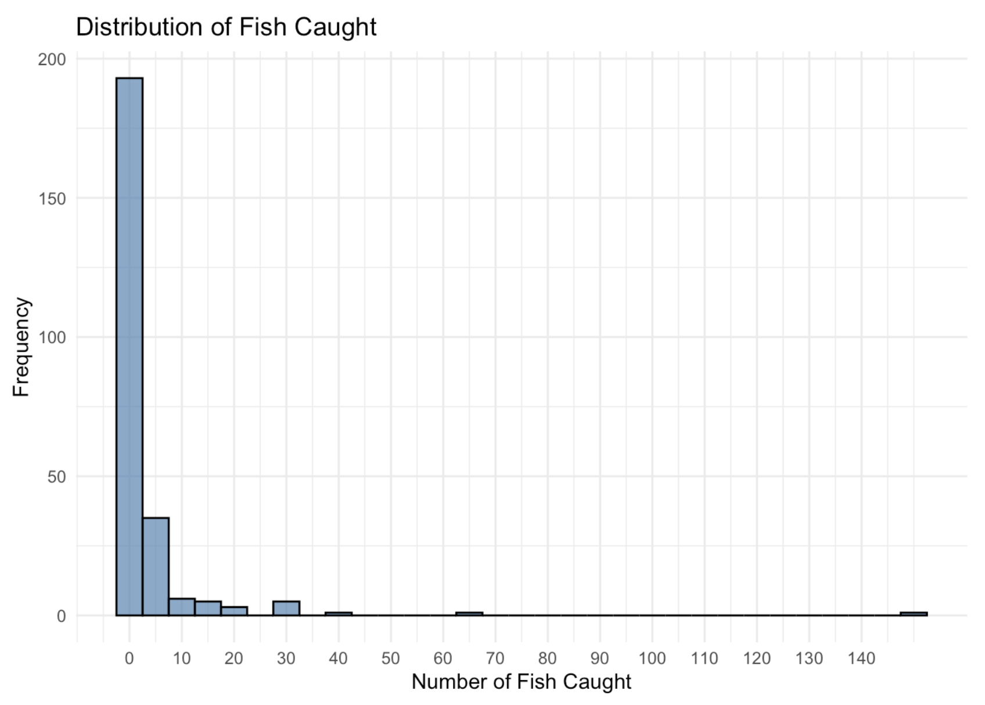
Challenges
We do not know whether each group visited the park to fish.
Overdispersion
Overinflated zero
If a group used livebait, it is a definitive sign of fishing, even if the count is zero.
Count of children is nested in count of persons.

Slide 4
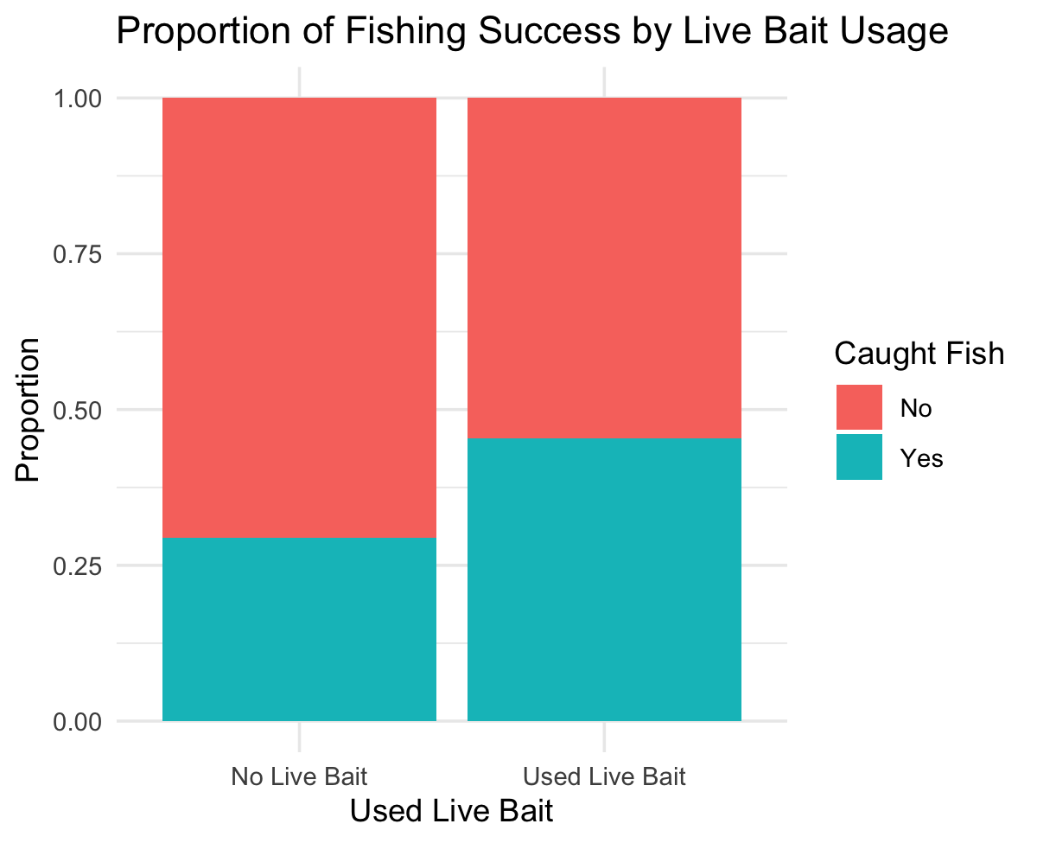
Challenges
We do not know whether each group visited the park to fish.
Overdispersion
Overinflated zero
If a group used livebait, it is a definitive sign of fishing, even if the count is zero.
Strong correlation between true state of going fishing and live bait use
Count of children is nested in count of persons.

Slide 5
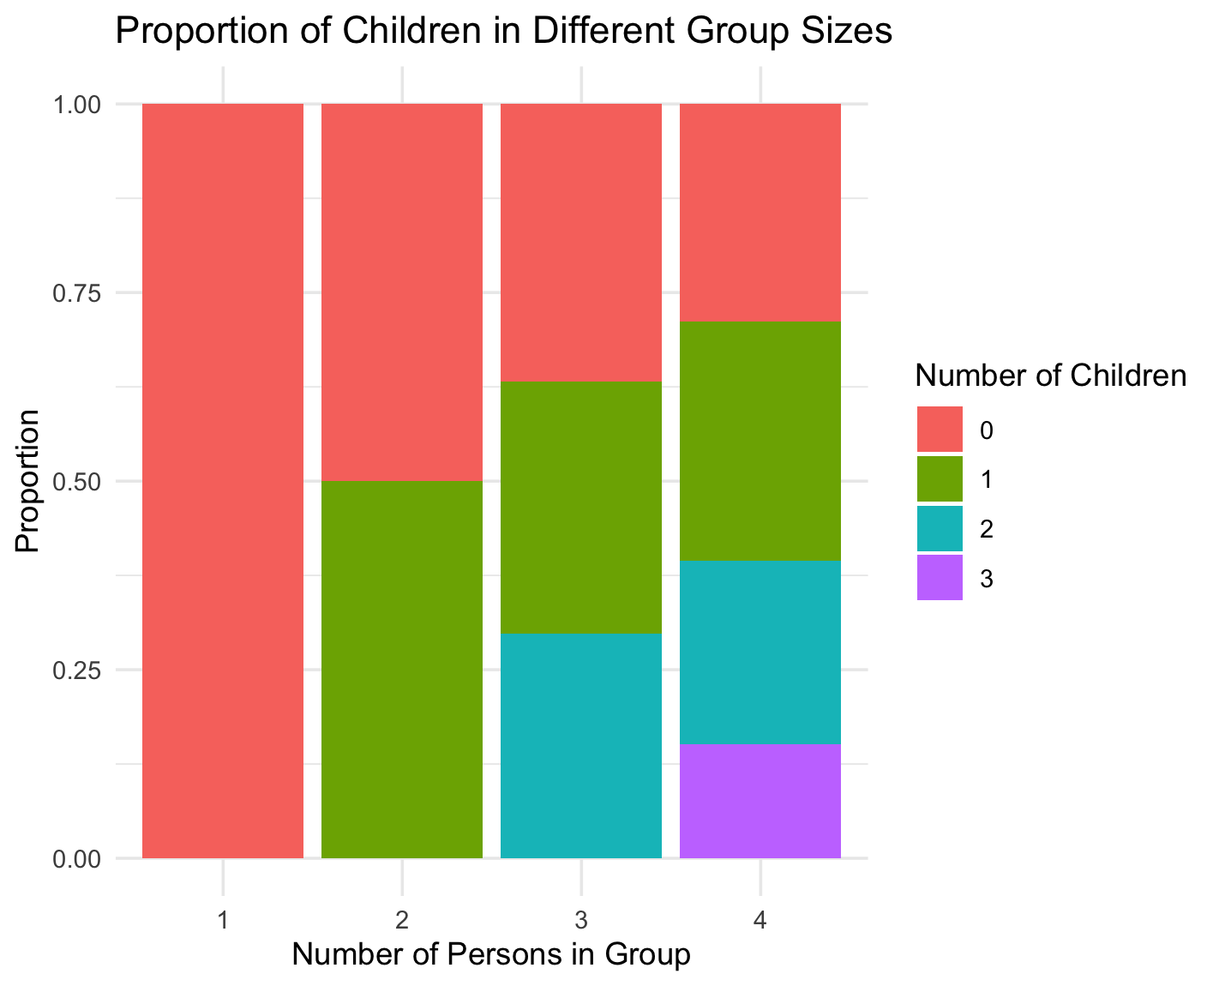
Challenges
We do not know whether each group visited the park to fish.
Overdispersion
Overinflated zero
If a group used livebait, it is a definitive sign of fishing, even if the count is zero.
Count of children is nested in count of persons.
Correlated Variables

Slide 6


Model Formulation
Possible Models to Consider:
Poisson
Sample mean: 3.296
Sample variance: 135.38

Slide 7

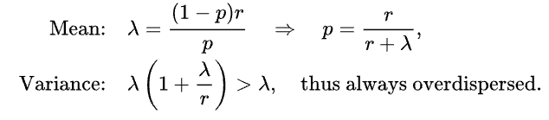
Model Formulation
Possible Models to Consider:
Poisson
Negative Binomial
But Negative Binomial does not incorporate the latent variable of whether each group went fishing.
Relationship with Poisson:

Slide 8
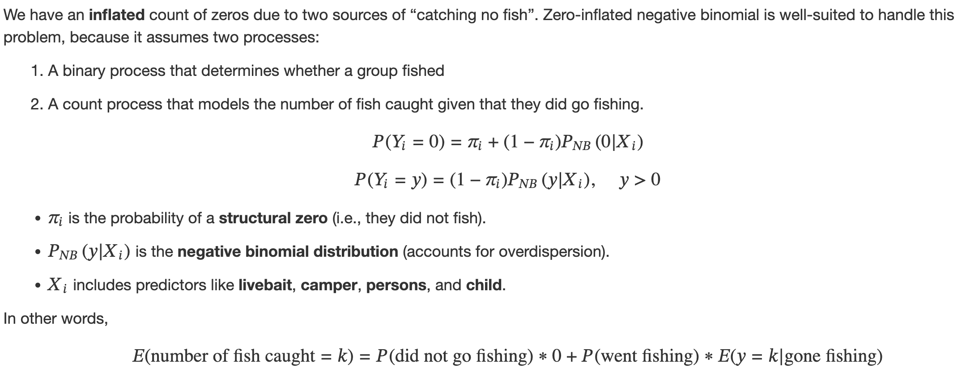
Model Formulation
Possible Models to Consider:
Poisson
Negative Binomial
Zero-Inflated Negative Binomial

Slide 9
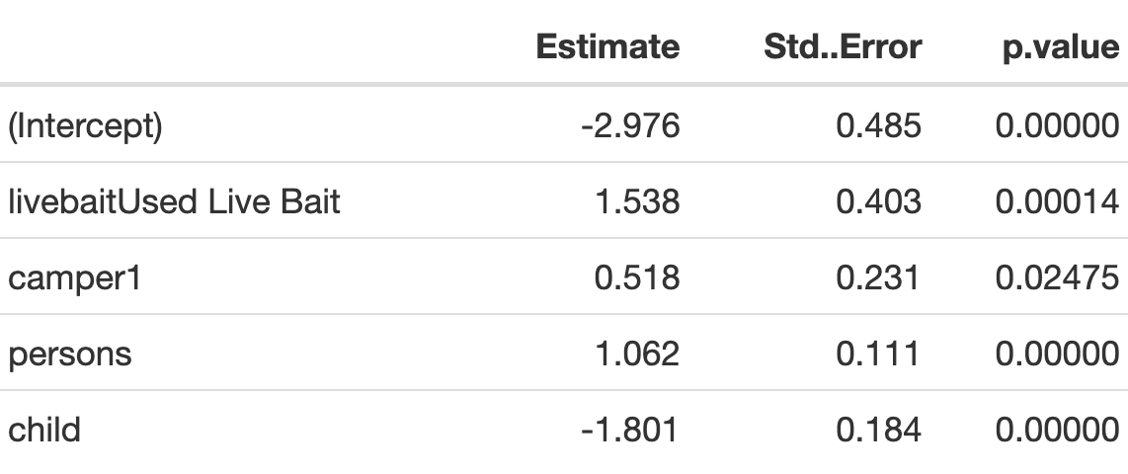
Model 1: Simple NegBin
**Reminder: we use log link, meaning we estimate log(count)
MASS::glm.nb( count ~ livebait + camper + persons + child)
Use of live bait increased the number of caught fish by exp(1.532) = 4.627 times.
Groups that did camp had higher counts of caught fish.
Bigger groups caught more fish than smaller groups.
Groups with more children caught less fish.
Theta = 0.515 (significant overdispersion)

Slide 10
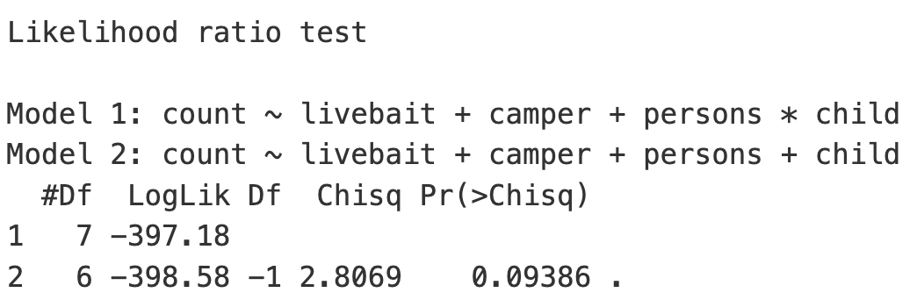
Child vs. Persons
The interaction between the group size and number of children is not significant to our analysis.

Slide 11
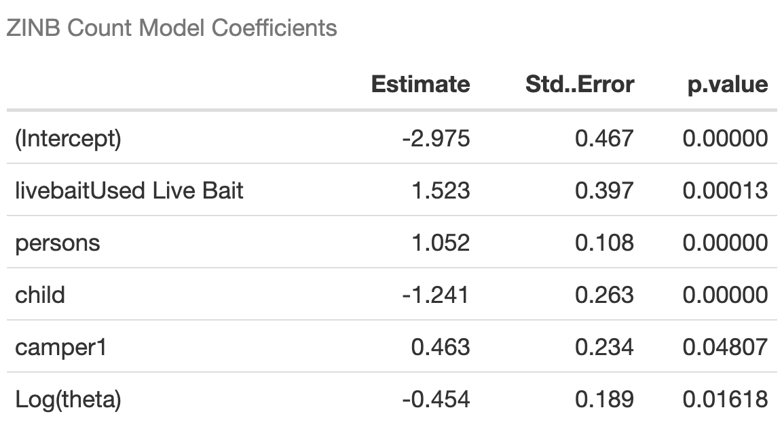
Model 2: Zero-Inflated NegBin
Pscl::zeroinfl( count ~ livebait + camper + persons + child | child, dist = "negbin")
The zeroinfl() model in the "pscl" package in R takes formula as "y ~ x1 + x2 | z1 + z2" where
"y ~ x1 + x2" is the count model and
"y ~ z1 + z2" is the zero-inflated model
pscl package
Theta = exp(-0.454) = 0.63, significant

Slide 12
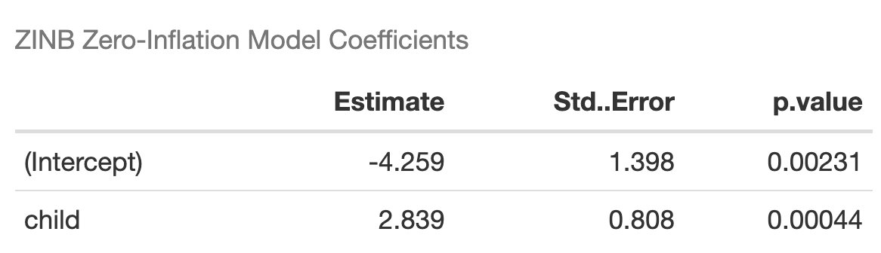
Model 2: Zero-Inflated NegBin
Pscl::zeroinfl( count ~ livebait + camper + persons + child | child, dist = "negbin")
The zeroinfl() model in the "pscl" package in R takes formula as "y ~ x1 + x2 | z1 + z2" where
"y ~ x1 + x2" is the count model and
"y ~ z1 + z2" is the zero-inflated model
pscl package

Slide 13
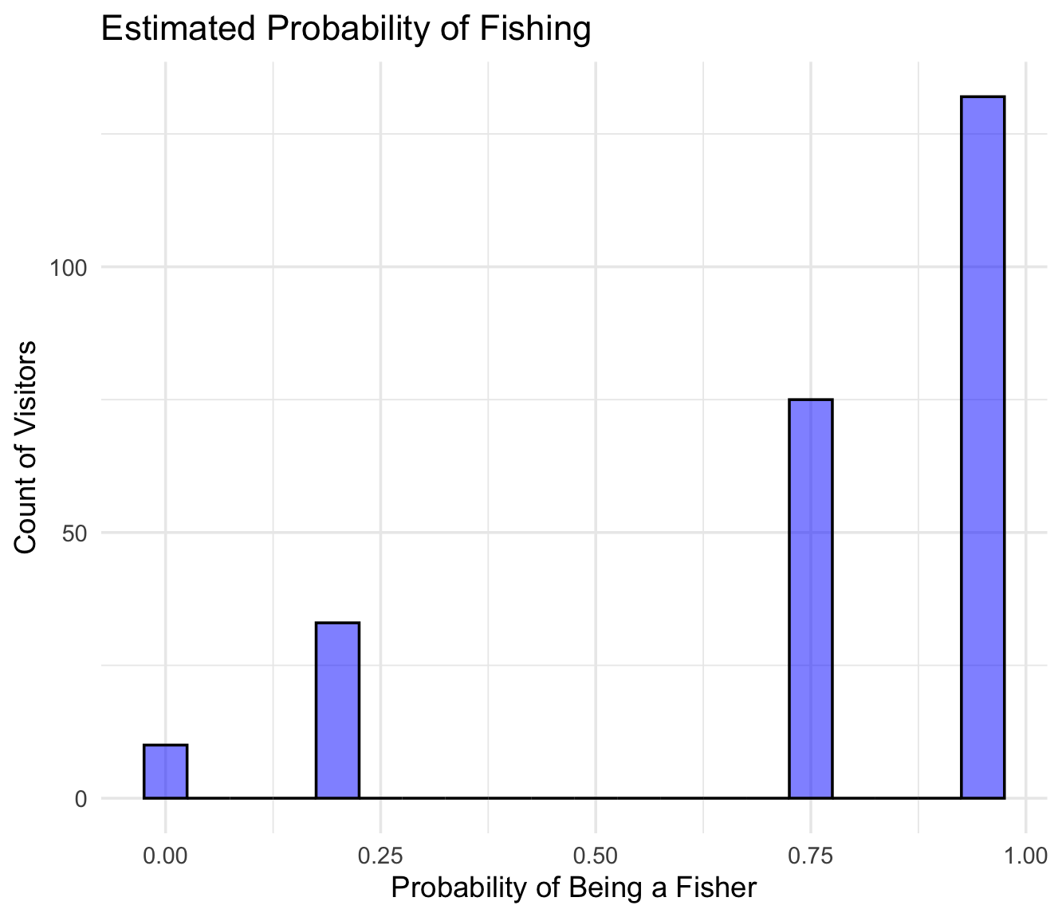
ZINB Results
Overall average of a group having really fished (average posterior probabilities): 0.76
This means that the model believes that most visitor groups (76%) actually fished.

Slide 14
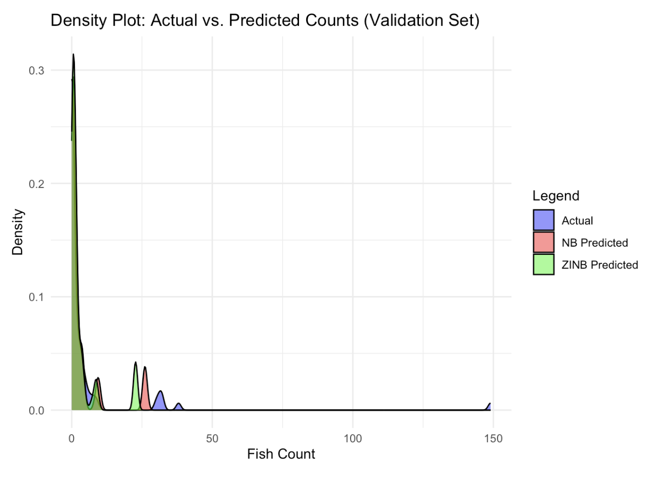
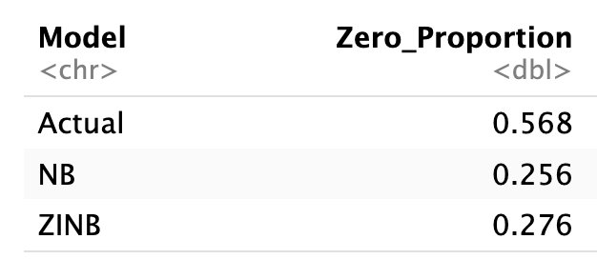
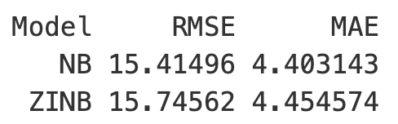
Performance Comparison
70 – 30 training based Performance:

Slide 15
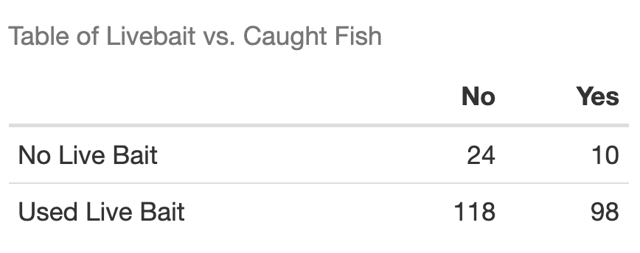
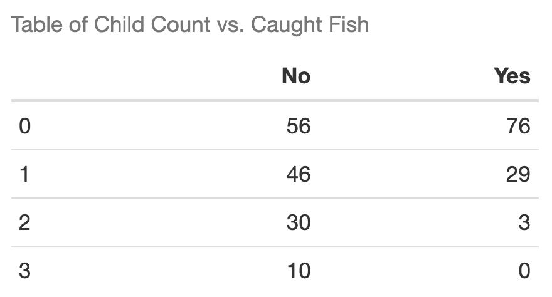
Conclusion
Negative Binomial did an adequate job at count prediction.
Most groups did indeed visit the park to fish – ZINB and NB models yielded similar results.
The state park must be a famous spot for fishing!

Slide 16
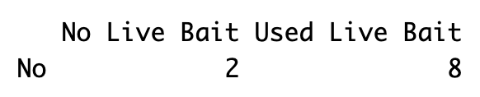
Conclusion
Negative Binomial did an adequate job at count prediction.
Most groups did indeed visit the park to fish – ZINB and NB models yielded similar results.
ZINB and NB results agree – don't bring your kids to go fishing!

